Slide 1

AI & MACHINE LEARNING ANALYSIS OF CAPTAIN OF ALL THESE MEN OF DEATH - TUBERCULOSIS Tuberculosis - Captain of all these Men of Death
PP-3
Name of the Student: Gunjan Deshpande
Program: B. Tech Bioinformatics and Data Science
Roll Number: BID 19006 Date of Submission 30/10/2022

Slide 2
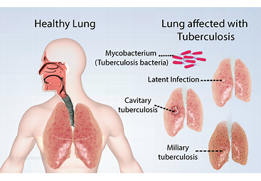
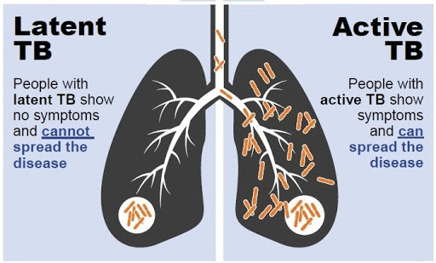
Introduction and Gap in the Research
PP-3
Introduction:
There are two different types, latent TB and active tuberculosis. Latent TB occurs when a person has the TB bacteria in their body. But the bacteria are present in extremely small numbers. People with latent TB are not infectious and do not feel ill. They cannot pass the TB bacteria on to other people. TB disease or Tuberculosis is what happens when a person has latent TB and then becomes sick. Sometimes this is known as having active TB.
TB bacteria are spread through the air from one person to another when a person with TB disease coughs, speaks or sings. When a person breathes in TB bacteria, the bacteria can settle in the lungs and begin to grow. From there they can move through the blood to other parts of the body.
Name of the Student Gunjan Deshpande Roll No BID 19006

Slide 3
Introduction and Gap in the Research
PP-3
Gap between diagnosis and treatment:
Point-of-care rapid diagnostic methods at the outset of the diagnostic process can revolutionize the treatment of MDR- and XDR-TB by enabling the use of a tailored drug therapy
Countries should ensure that patients diagnosed through these measures are provided access to the most appropriate drugs
Scaling up and providing treatment, including treatment for MDR-TB (Multidrug-Resistant)and XDR-TB(Extensively Drug-Resistant) is an essential element of providing ethical TB care (universal access to care)
While countries are in the process of scaling up treatment for MDR/XDR-TB, the use of drug susceptibility testing may be appropriate
May be used as an interim measure even where:
Second- or third-line drug treatment is not available
The only available treatment is substandard
Patients MUST be asked to provide informed consent for diagnostic testing in absence of treatment
Countries, TB Programmes and providers should focus on ensuring adequate treatment is available for all who are diagnosed with drug-resistant TB
Name of the Student Gunjan Deshpande Roll No BID 19006

Slide 4
Objectives and Outcomes of the Research
PP-3
Objectives:
Discuss reasons for and challenges with gap between diagnosis and treatment of drug-resistant TB and need to address this gap
Explain the benefits of drug susceptibility testing in the absence of drug-resistant TB treatment
Demonstrate why education and counselling forms an essential component of patient care in the absence of drug susceptibility testing (DST) and appropriate treatment for drug-resistant TB
Outcomes:
Making ethically appropriate treatment decisions in absence of DST.
Ethical approach to scaling up MDR/XDR-TB treatment
Name of the Student Gunjan Deshpande Roll No BID 19006

Slide 5
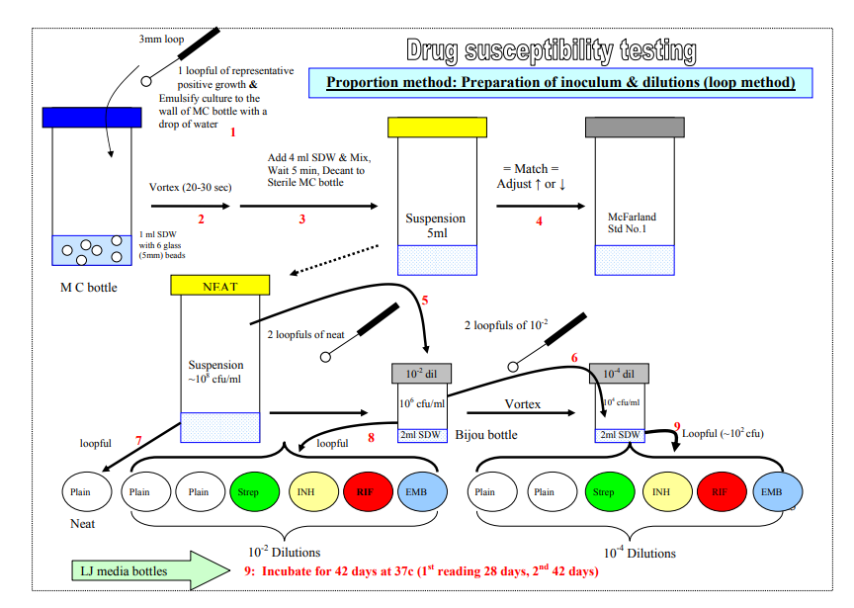
Materials and Methods
THE ABSOLUTE CONCENTRATION METHOD: This method uses a standardized inoculum grown on drug-free media and media containing graded concentrations of the drug(s) to be tested. Several concentrations of each drug are tested, and resistance is expressed in terms of the lowest concentration of the drug that inhibits growth; i.e., minimal inhibitory concentration (MIC). This method is greatly affected by inoculum size and the viability of the organisms.
THE RESISTANCE RATIO METHOD: It compares the resistance of unknown strains of tubercle bacilli with that of a standard laboratory strain. Parallel sets of media, containing twofold dilutions of the drug, are inoculated with a standard inoculum prepared from both the unknown and standard strains of tubercle bacilli. Resistance is expressed as the ratio of the minimal inhibitory concentration (MIC) of the test strain divided by the MIC for the standard strain in the same set.
PP-3
THE PROPORTION METHOD: 1 ml SDW with six 3 mm glass beads + 1 loopfull (3 mm internal diameter) of
culture , vortexed for 20 – 30 seconds , Add 4 ml of SDW to the above, Adjusted turbidity with McFarland 0.05 with SDW, 2 loopfull of neat + 2ml of SDW , 2 loopful of S2 + 2ml of SDW
Materials:
Preparation of 1%CPC-NaCl and Preparation of Sterile 4% NaOH solution / other tests:
1ml SDW with six 3 mm glass beads + 1 loopfull (3 mm internal diameter) of culture
1% aqueous barium chloride and 1% sulphuric acid (AR)
Sputum smear
20mg of isoniazid
20mg of ethambutol
20mg / Potency of dihydro streptomycin sulphate
Cyanogen bromide solution
0.067M phosphate buffer solution
Bovine albumin-dextrose complex - 100 ml
Bovine albumin, Fraction V - 5 g
5 ml of CPC (cetylpyridinium chloride)
10 grams of Sodium Hydroxide
Name of the Student Gunjan Deshpande Roll No BID 19006

Slide 6
Time Line or Milestones to be achieved
PP-3
Function | Software/ Webserver Name | Availability | Website
Comparative modeling | SWISS-MODEL [32] | Free webserver | https://swissmodel.expasy.org/
Structural geometry confirmation | MODELLER [33] | Free standalone program for academic license or commercially available through BIOVIA | https://salilab.org/modeller/ https://www.3dsbiovia.com/
 | Robetta [34] | Free webserver | http://new.robetta.org/
 | Prime [35] | Commercially available through Schrödinger | https://www.schrodinger.com/prime
 | I-TASSER [36,37,38,39,40,41] | Free webserver or standalone program for academic license | https://zhanglab.ccmb.med.umich.edu/I-TASSER/
 | HHPred [42,43,44] | Free webserver | https://toolkit.tuebingen.mpg.de/tools/hhpred
Structural geometry confirmation | PROCHECK [45] | Free webserver and source code | https://www.ebi.ac.uk/thornton-srv/software/PROCHECK/
Druggability and binding site prediction Druggability and binding site prediction | ProSA [46] | Free webserver | https://prosa.services.came.sbg.ac.at/prosa.php
 | VERIFY3D [47] | Free webserver | https://servicesn.mbi.ucla.edu/Verify3D/
 | ERRAT [48] | Free webserver | https://servicesn.mbi.ucla.edu/ERRAT/
 | PockDrug [49] | Free webserver | http://pockdrug.rpbs.univ-paris-diderot.fr/cgi-bin/index.py?page=home
 | DoGSiteScorer [50] | Free webserver | https://proteins.plus/
 | fpocket [51,52] | Free/open source platform | https://github.com/Discngine/fpocket
 | CASTp [53,54,55] | Free webserver | http://sts.bioe.uic.edu/castp/calculation.html
 | PocketQuery [56] | Free webserver | http://pocketquery.csb.pitt.edu/
 | PASS [57] | Free/open source platform | http://www.ccl.net/cca/software/U
30-10-2022
Name of the Student Gunjan Deshpande Roll No BID 19006

Slide 7
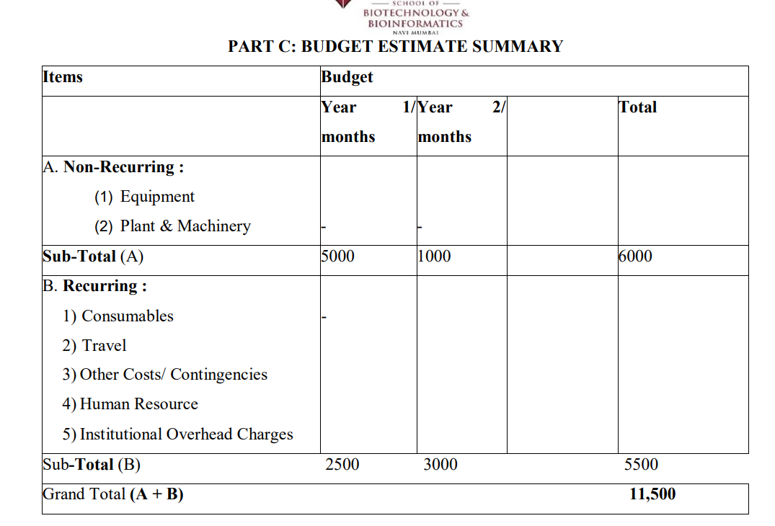
Justification for the Projected Budget
PP-3
Wet-laboratory experiments
Quality equipment and related supplies
In silico software
30-10-2022
Name of the Student Gunjan Deshpande Roll No BID 19006

Slide 8
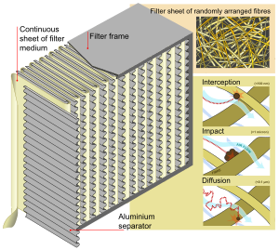
Social and Environmental impact/ Entrepreneurship
PP-3
The single most important piece of laboratory equipment needed in a tuberculosis culture laboratory is a well-maintained, properly functioning biological safety cabinet (BSC). These cabinets have been designed to provide a combination of staff, environmental or product protection when appropriate practices and procedures are followed. Mycobacterium tuberculosis is classified under Risk Group III.
30-10-2022
Name of the Student Gunjan Deshpande Roll No BID 19006

Slide 9
REFERENCES
PP-3
https://tbfacts.org/get-spread-tb/
https://tbcindia.gov.in/WriteReadData/l892s/6995271860Training%20manual%20M%20tuberculosis%20C%20DST.pdf
https://www.ncbi.nlm.nih.gov/pmc/articles/PMC2592293/#:~:text=For%20centuries%2C%20TB%20has%20been,conditions%2C%20and%20excessive%20alcohol%20use
https://en.wikipedia.org/wiki/HEPA
https://www.ncbi.nlm.nih.gov/pmc/articles/PMC3499631/
https://www.intechopen.com/chapters/43723
30-10-2022
Name of the Student Gunjan Deshpande Roll No BID 19006

Slide 10
Collaborations/ Collaborators if any
PP-3
No Collaborations
30-10-2022
Name of the Student Gunjan Deshpande Roll No BID 19006

